Slide 1
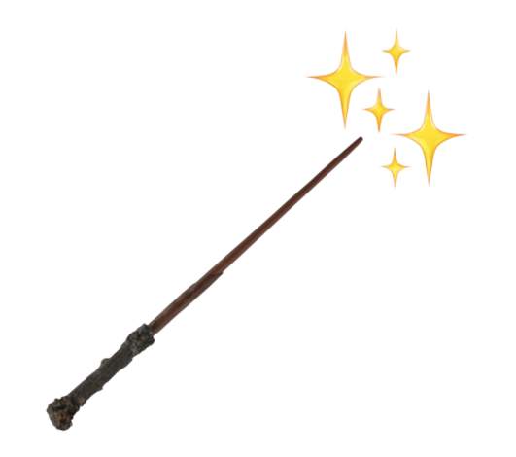

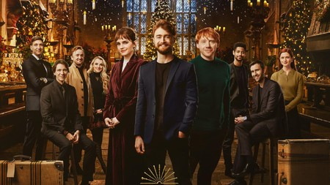
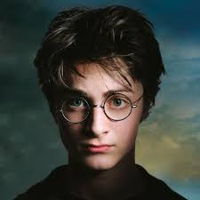
Magic room
Battle
Film
Gryffindor
Harry Potter
Daniel racdlife as harry potter, the main character isaasasads sfgrjikyjtd avdsrjegethrh fwdfwdf harry potter, the main character isaasasads Asdasdasdasd sfgrjikyjtd avdsrjegethrh fwdfwdf otter, the main character isaasasads Asdasdasdasd sfgrjikyjtd avdsrjegethrh fwdfwdfotter, the main character
Daniel racdlife as harry potter, the main character isaasasads sfgrjikyjtd avdsrjegethrh fwdfwdf harry potter, the main character isaasasads Asdasdasdasd sfgrjikyjtd avdsrjegethrh fwdfwdf
Daniel racdlife as harry potter, the main character isaasasads sfgrjikyjtd avdsrjegethrh fwdfwdf harry potter, the main character
Harry Potter
Daniel racdlife as harry potter, the main character isaasasads sfgrjikyjtd avdsrjegethrh fwdfwdf harry potter, the main character
Harry Potter
Daniel racdlife as harry potter, the main character isaasasads sfgrjikyjtd avdsrjegethrh fwdfwdf harry potter, the main character Daniel racdlife as harry potter, the main character isaasasads sfgrjikyjtd avdsrjegethrh fwdfwdf harry potter, the main character
Daniel racdlife as harry potter, the main character isaasasads sfgrjikyjtd avdsrjegethrh fwdfwdf harry potter, the main character
Harry Potter
House and Characters
Others characters
Gryffindor
Gryffindor
Gryffindor
Gryffindor
House and Characters

Slide 2
Magic room
Battle
Film
Magic room
Battle
Film
Inspacitolore
Daniel racdlife as harry potter, the main character isaasasads sfgrjikyjtd avdsrjegethrh fwdfwdf harry potter, the main character Daniel racdlife as harry potter, the main character isaasasads sfgrjikyjtd avdsrjegethrh fwdfwdf harry potter, the main character
Inspacitolore
Inspacitolore
VS
5
Fight
3
Change Character
Demo
Demo
Demo
Demo
Demo
Demo
Demo
Demo
Demo

Slide 3

Magic room
Battle
Film \/
Sorcerer Stone
<
>
Story Line
Daniel racdlife as harry potter, the main character isaasasads sfgrjikyjtd avdsrjegethrh fwdfwdf harry potter, the main character Daniel racdlife as harry potter, the main character isaasasads sfgrjikyjtd avdsrjegethrh fwdfwdf harry potter, the main character

